Slide 1
Linux and Linux distro and SUSE
Liang Yan
SUSE software engineer (virtulization)
Cloud specialist

Slide 2
Linux and Linux Distro and SUSE
What is Linux
Why Linux Distro
How SUSE works
My work in Virtulization Team

Slide 3

Linux
An operating system
Linux Windows Mac OSX(Darwin) Unix FreeBSD
Solaris ChromeOS
IOS Android Sabian WebOS
Vxworks, embeded linux windows CE

Slide 4
Linux
Linux is a Unix clone written from scratch by Linus Torvalds with assistance from a loosely-knit team of hackers across the Net.
Unix is a multitasking, multi-user computer operating system originally developed in 1969 by a group of AT&T employees at Bell Labs.
Linux and Unix strive to be POSIX compliant.
64% of the world’s servers run some variant of Unix or Linux. The Android phone and the Kindle run Linux.

Slide 5
Linux
Kernel+driver module
Toolchain
X-windows xorg→wayland
Desktop: gnome kde
Systemd <> SystemV
Wicked <> NetworkManager
All other packages:

Slide 6
Linux
In development for over twenty years
● A new version is released every ~3 months
● ~3.5 commits every hour to the upstream kernel
● ~15 million lines of code

Slide 7
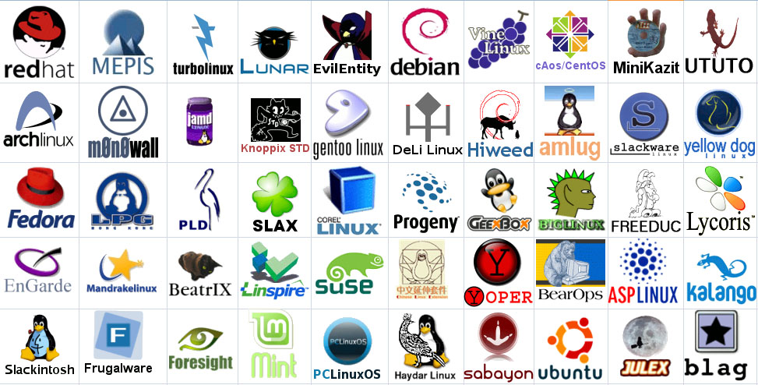
Linux Distro
https://en.wikipedia.org/wiki/List_of_Linux_distributions

Slide 8
Linux Distro
Why we should use a Distro:
Easy, Stable, Safe
Linux scratch: http://www.linuxfromscratch.org/lfs/
Full partership: hardware company
1. intel amd arm ibm --- SEV
2. nvidia intel amd --- GPU virtualization
3. network card : intel mellanox
4. disk driver: nvme
5. and so on
Security support: maintain and vulnerable patch
Long Term Technical support(13+)

Slide 9
Linux Distro
Distributions (distro) :
Same:
1. all from upstream
2. Open source
3. Community
Diff:
○ Different version number
○ Different package system, configuration etc.
○ Different maintain support system

Slide 10
Linux Distro
Ubuntu
bionic(18.04 LTS) 1:2.11+dfsg-1ubuntu4
artul(17.10) 1:2.10+dfsg-0ubuntu3.5 4.13
zesty(17.04) 2.8 4.10
Yakkety(16.10) 2.6.1 4.8
Xenial(16.04 LTS) 1:2.5+dfsg-5ubuntu10.24 4.4
Wily(15.10) 2.3 4.2
Vivid(15.04) 2.2 3.19
Utopic (14.10) 2.1 3.16
trusty(14.04 LTS) 2.0.0+dfsg-2ubuntu1.40 3.13

Slide 11
Linux Distro
SUSE
SLES15 2.11.1
SLES12SP4
SLES12SP3 2.10.1 4.4.73-114
SLES12SP2 2.6.3 4.4.21-114
SLES12SP1 2.3.1 3.12.49-74
SLES12GM 2.0.2 3.12.28-61
SLES11SP4 1.4.2 3.0.101-108
SLES11SP3 1.4.2 3.0.76-101
SLES11SP2 0.15.1 3.0.13-101
SLES11SP1 0.12.5 2.6.32

Slide 12
Fedora
Rawhide 2.11.0-5.fc29
Fedora 28 2.11.0-4.fc28
Fedora 27 2.10.1-2.fc27 4.13
Fedora 26 2.9.1-2.fc26 4.11
Fedora 25 2.7.1-7.fc25 (2017-12-12) 4.8
Fedora 24 2.6.2-8.fc24 2017-08-08 4.5
Fedora 23 2.4.1-11.fc23 2016-12 4.2
Fedora 22 2.3.1-16.fc22 4.0
Red Hat Enterprise Linux 7 3.10.0
7.4 8/31/2019
7.3 11/30/2018
7.2 11/30/2017
7.1 3/31/2017
Red Hat Enterprise Linux 6 2.6.30
6.7 12/31/2018
6.6 10/31/2016
6.5 11/30/2015
6.4 3/3/2015
Red Hat Enterprise Linux 5
5.9 3/31/2015
5.6 7/31/2013

Slide 13
Linux Distro
Other related Enterprise productions:
Manage system SUSE-manager
Cloud System
CAAS/ openshit
Storage: Ceph
High Availability

Slide 15
SUSE
SLES
Opensuse
==========
Yast: Adminstrator
OBS: build machine
OpenQA: test machine
Studio
------------------------
CICD: github+obs+openqa

Slide 16
SUSE
Life Cycle:
Full support: 5 years
Maintenance support: 5 years
Extend: (LTSS)3 year
ReActivate

Slide 17
Linux Distro
O Release Date| Patch ReleaseDate| Extended Support End Date
Red Hat 5.x | 2015­11­01| 2017­01­01| Not available
Red Hat 6.x |Q2 2016| Q2 2017 |2020­11­30
Red Hat 7.x |Q4 2019| Q4 2020 |Q4 2023
Debian 6 (Squeeze)| 2015­11­01| 2016­02­06| 2019­06­02
Debian 7 (Wheezy) |Est. 2016­04­30 |Est. 2020­04­30| Est 2023­04­30
Debian 8 (Jessie) |Est. 2018­04­30| Est 2022­04­30 |Est 2025­04­30

Slide 18
SUSE Virtualization Team
Xen KVM Libvirt Virt-Manager QEMU
Seabios UEFI
Cloud
Related: kernel driver

Slide 19

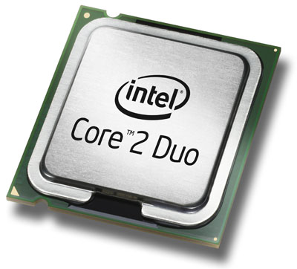
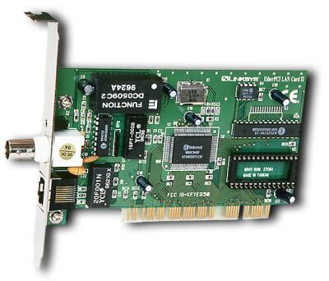
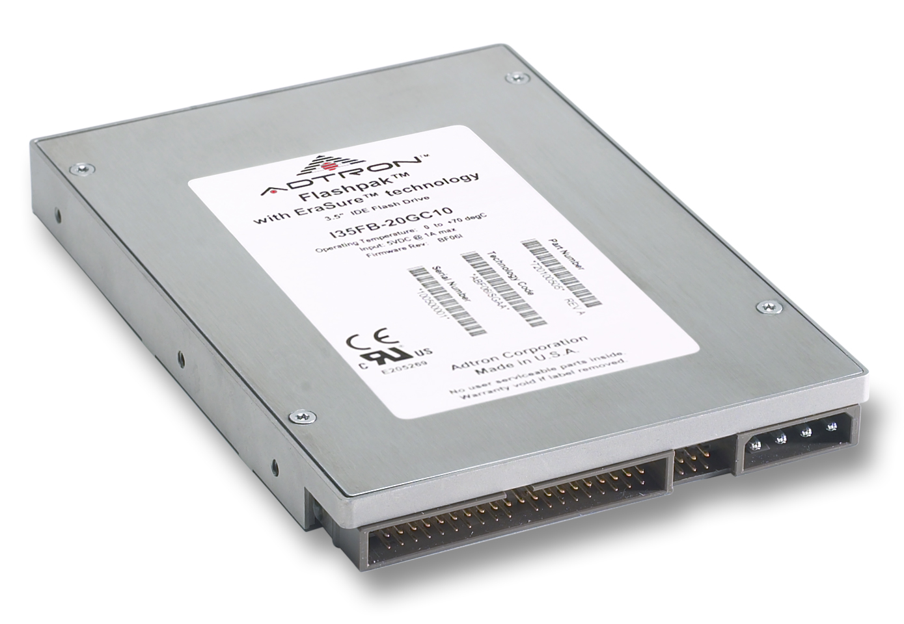
Suse Virtualization
Virtual
Container
Virtual
Container
App. A
App. B
App. C
App. D
App. A
App. B
App. C
App. D
Operating System
Virtualization Layer
Hardware
Hardware
‘Nonvirtualized’ system
A single OS controls all hardware platform resources

Slide 20
Suse Virtualization
App
App
App
App
App
App
App
App
App. A
App. B
App. C
App. D
X86
Windows
XP
X86
Windows
2003
X86
Suse
X86
Red Hat
X86
Windows
XP
X86
Windows
2003
X86
Suse
Linux
X86
Red Hat
Linux
12% Hardware
Utilization
15% Hardware
Utilization
18% Hardware
Utilization
10% Hardware
Utilization
X86 Multi-Core, Multi Processor
70% Hardware Utilization

Slide 21
Suse Virtualization
Production online:
Project Decision
Alpha1-5
Beta1-3
GMC
Maintain Process
1. GM version
2. Bug
3. PTF
4. Feature
5. Security update
6. Upgrade

Slide 22
Suse Virtualization
1. mailing-list
2. irc
3. Conference

Slide 23
Suse virtualization
Questions?

